Slide 1







Assessing the Impact of an Interactive “GPS Mission” Game on Physical Activity (Part 2)
By: Jenna Larsen
Mentor: Kay Hongu
Arizona/NASA Space Grant Statewide Symposium
Kuiper Space Sciences building
April 17th 2010

Slide 2
Acknowledgements
Nobuko (Kay) Hongu, RD, PhD- Mentor: Nutritional Sciences Extension Specialist (UA)
Barron Orr, PhD- Mentor: Arid Lands Studies (UA); Geospatial Extension Specialist
Scott Going, PhD- Professor: Nutritional Sciences Dept.
Denise Roe, DrPH- Professor and Section Chief, Biostatistics
Kristin Wisneski- Rangeland Ecology and Management Graduate Student
NPA Research Team- Martha Mosqueda, Rosalie Thornton, Rebecca Reed, Nick Knutson, Bianca Teran, Kristin Gemma, Jena Panebianco,

Slide 3
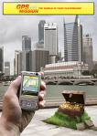
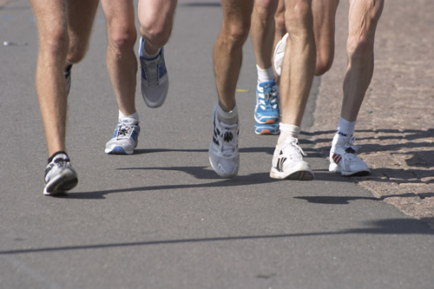
Objective
To determine if ‘GPS Mission’ will enhance physical activity (PA) among college students

Slide 4
Methods
Participants: Twenty (10 men and 10 women), healthy adults, aged 18-24 y
Experimental Groups: Control and ‘GPS Mission’
Preliminary Study:
  Control: 3 adults
  ‘GPS Mission’: 3 adults

Slide 5
Experimental Design
Groups
Baseline/PA Assessment
Control
PA Brochure
Routes Instruction
Routes Competition
Follow-up/ No treatment
Route mapping instruction
Follow-up/ No treatment
-7-day
0-day
7-day
14-day
21-day
28-day
35-day
‘GPS Mission’
PA Brochure
‘GPS Mission’ Instruction
‘GPS Mission’ Competition
Follow-up/ No treatment
Create a ‘Mission’ instruction
Follow-up/ No treatment
Pedometer and ‘Physical Activity Log’ collection

Slide 6
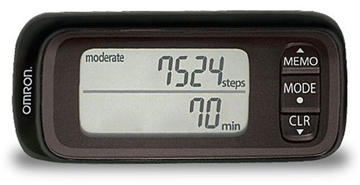
Measurements
Pedometer
  Omron 303
Questionnaire
Physical Activity Log
* Baseline measurements will be compared to
data collected throughout experiment
Omron 303 Pedometer

Slide 7
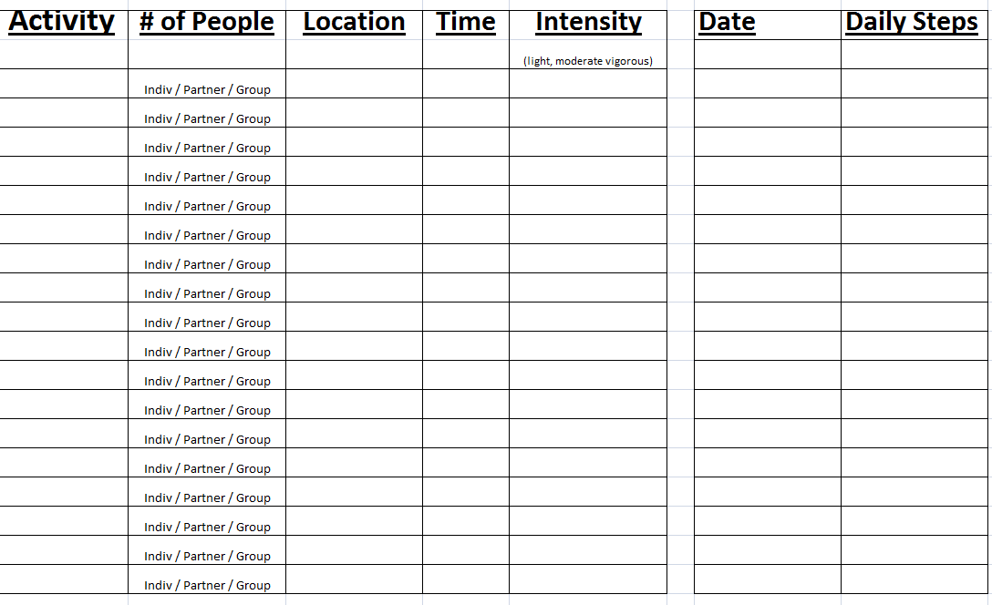
Physical Activity Log
Insert screenshot from Rosie

Slide 8
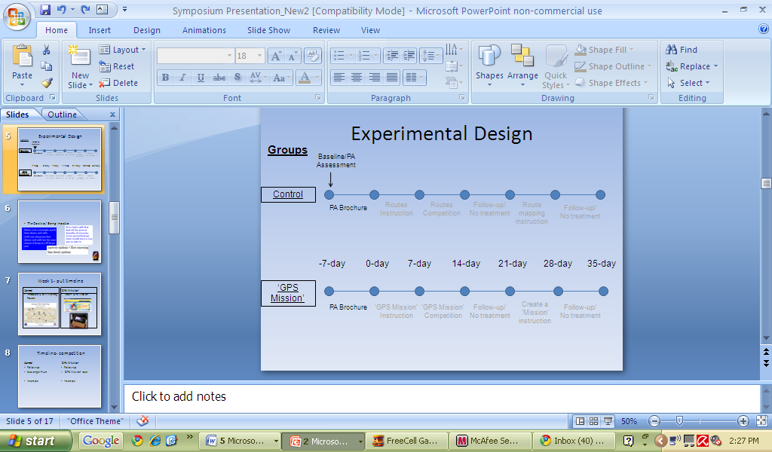
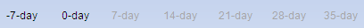
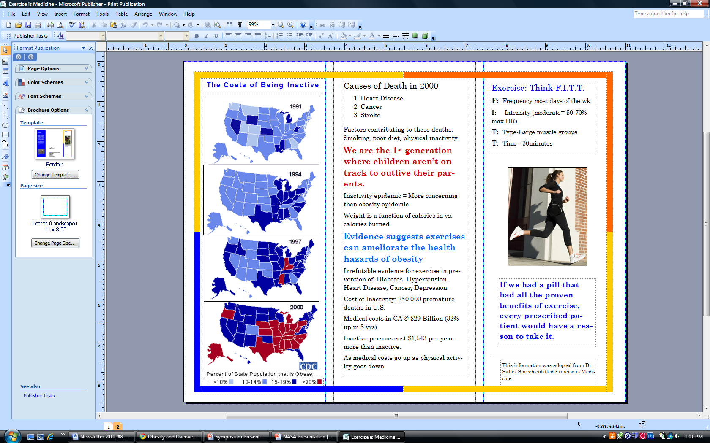
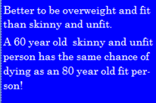
PA Brochure: The Costs of Being Inactive

Slide 9


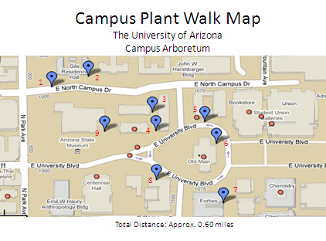
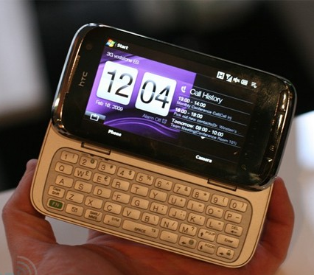
‘GPS Mission’
Control
Teach ‘GPS Mission’
Introduce U of A Walking Routes

Slide 10
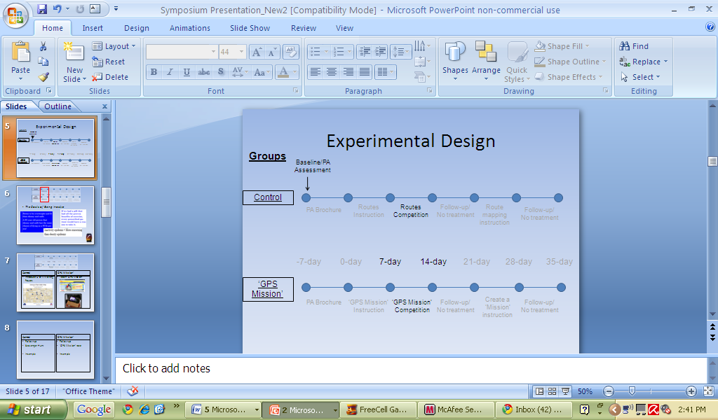
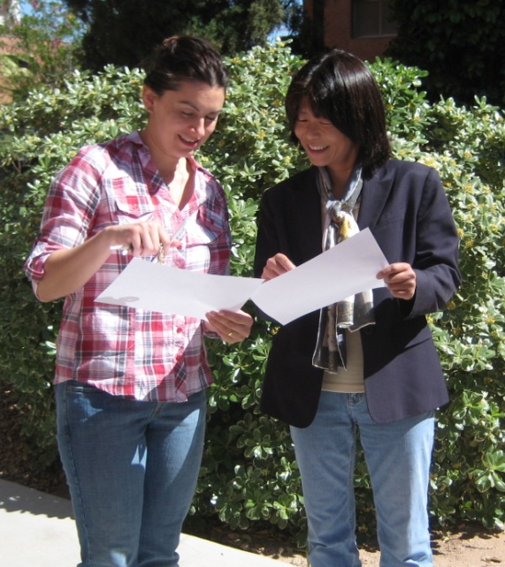
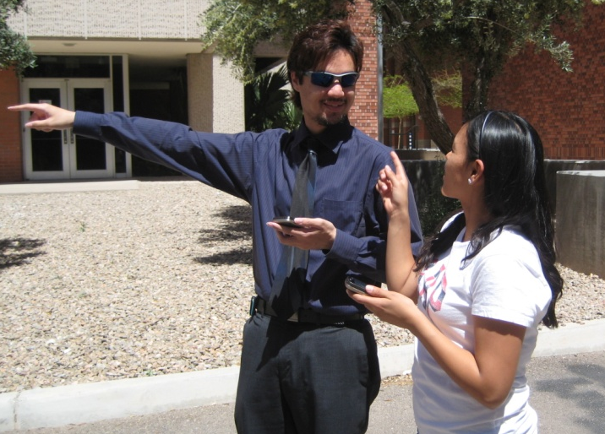
‘GPS Mission’
Control
Follow-up
‘GPS Mission’ race
Follow-up
Scavenger hunt

Slide 11
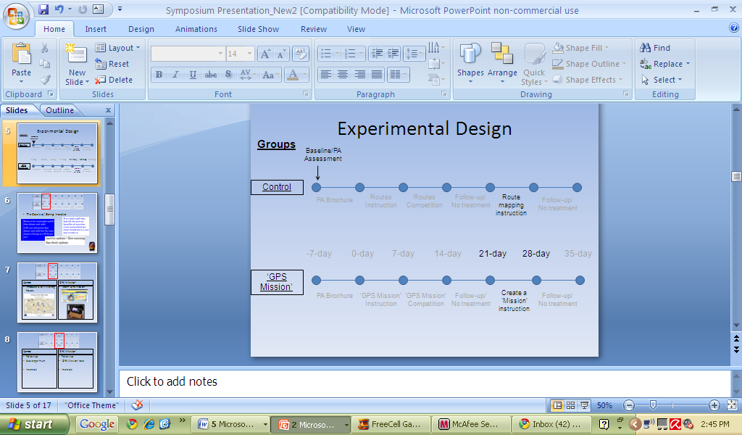
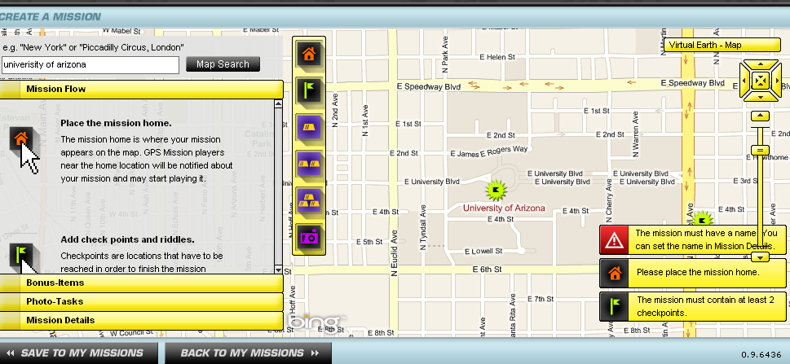
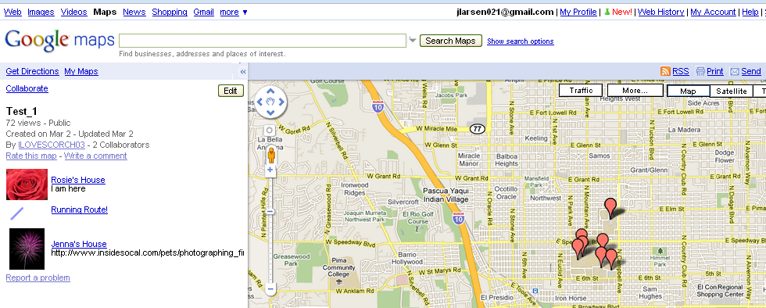
‘GPS Mission’
Creating a ‘Mission’
Control
Creating a Route

Slide 12
Preliminary Results
Control (2 women, 21 y; 1 man, 24 y)
  Average Baseline Steps: 10,136 per day
‘GPS Mission’ (3 women, 19-20y)
  Average Baseline Steps: 9,408 per day

Slide 13
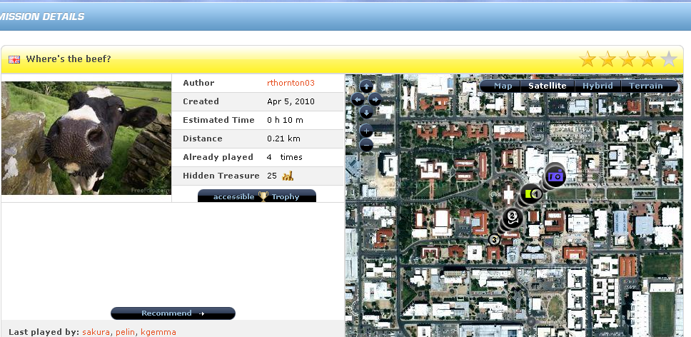
Preliminary Results

Slide 14
Significance of Study
Study will determine impact of technology on PA enhancement in college students
Findings will be used in Stealth Health Project
Knowledge gained:
  Multiple steps in study design process
  Team member support

Slide 15
Thank you!

Slide 16
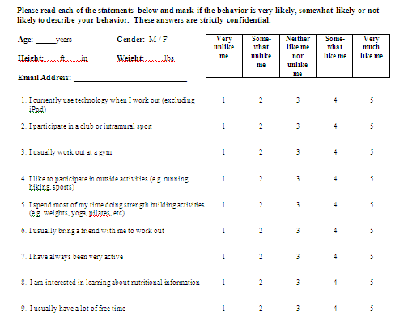
PA Questionnaire

